Slide 1
Module 2
Register transfer logic: inter register transfer — arithmetic, logic and shift micro
operations. Processor logic design: - processor organization — Arithmetic logic unit - design of arithmetic circuit - design of logic circuit - Design of arithmetic logic unit - status register —design of shifter - processor unit — design of accumulator.
Text :Mano M. M., Digital Logic & Computer Design, chapters 8 and 9

Slide 2
Micro-operations
Microoperations are the basic operations that can be performed by system on data stored in registers.
Microoperations are used by processors to complete their tasks to transfer data from one place to another.
Types of Microoperations
Inter register transfer micro-operations
Arithmetic micro-operations
Logic micro-operations
Shift micro-operations

Slide 3
Inter register transfer micro-operations
These micro-operations do not change the information content when the binary information moves from one register to another.
The registers in a digital system are designated by capital letters. Examples A, B, R1, R2 etc.
The register that holds the address of the memory unit is called Memory Address Register (MAR). The cells of an n bit register are numbered in sequence from 1 to n, starting either from the left or from the right.
A register can be represented in 4 ways

Slide 4
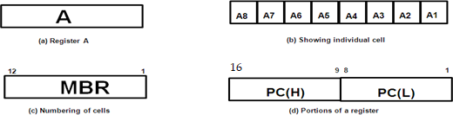
Figure (a) shows the most common way to represent a register is with a rectangular box in which name of the register is specified within the box.
In figure (b), it shows the individual cells of a register is assigned a letter with a subscript number and is marked from right to left.
The numbering of cells from right to left can be marked on top of the box as in figure (c).
A 16 bit register is partitioned into two parts, one high order part (H) consisting of eight high ordered cells and one lower order part (L) consisting of eight low ordered cells as in figure (d).

Slide 5
Conditional transfer
The condition that determines when the transfer is to occur is called a control function.
A control function is a Boolean function that can be equal to 0 or 1.
The control function can be specified with the following statement:
x'T1: A←B
It means that the transfer operation be executed by the hardware only when the Boolean function x'T1=1.That is, variable x=0 and timing variable T1=1.

Slide 6
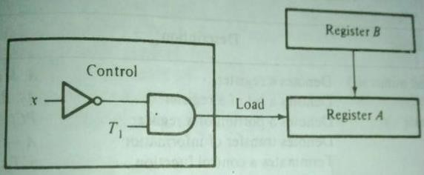
Conditional transfer
Example: Hardware implementation of a controlled transfer x'T1: A←B is shown in figure.
Here A←B transfers the contents of register B to register A. Contents of source register B do not change after the transfer.

Slide 7
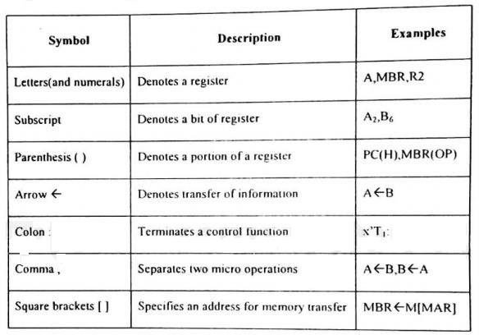
The basic symbols of the register transfer logic

Slide 8
Arithmetic Micro operations
The basic arithmetic micro-Operations are add, subtract, complement, and shift.
Add operation- It can be specified by the statement: F←A + B That is, the contents of register ‘A’ is added to the contents of register B and the sum is transferred to register F.
Here we require 3 registers and one digital circuit that perform addition operation such as parallel adder.
Arithmetic subtraction is implemented through complemented addition

Slide 9
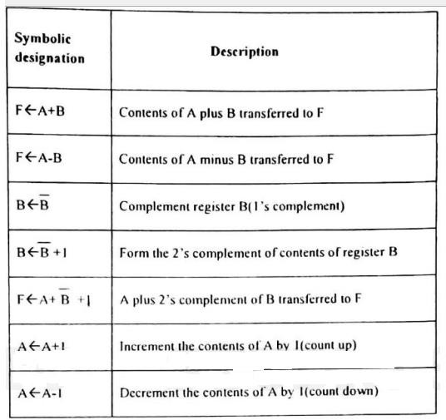
Basic arithmetic operations

Slide 10
Logic Micro Operations
Logic micro-operations specify binary operations for a string of bits stored in registers. These operations consider each bit in the registers separately and treat it as a binary variable.
For example, consider the AND operation of A and B.
Content of A is 1101 and content of B is 1010. Then, 1101(A) 1010(B)
A AND B will be 1000 (it will contain in the register F)
There are 16 different logic operations can be performed with two binary variables.
All 16 logic operations can be expressed in terms of the AND, OR and complement operations. Special symbols are adopted for these three micro operations.

Slide 11
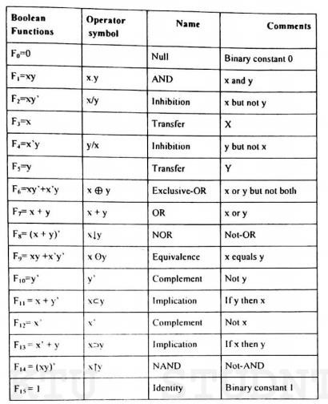

Slide 12

Shift Micro Operations
Shift micro-operations transfer binary information between registers in serial computers. They are also used in parallel computers for arithmetic, logic and control operations
Registers can be shifted to the left or right. There are no conventional symbols for shift. Here we are adopting the symbols shl and shr for shift left and shift right operations respectively.

Slide 13


Example 1: Shl A
Here when we are shifting to left the bit at position A0 is vacant. This gap can be filled by transferring the bit of position An in the original register
A. This can be considered as a circular shift. A←Shl A, A0 ←An
Example 2: Shr A
When we are shifting the register content to the right, the bit at position An is vacant. This gap can be filled by receiving the value of the 1 bit register E.
A←Shr A, An ←E

Slide 14
Design of arithmetic logic unit (ALU unit)
An ALU is a multioperation, combinational logic digital function.
It can perform a set of basic arithmetic operations and a set of logic operations.
The ALU has number of selection lines to select a particular operation in the unit. The selection lines are decoded within the ALU.
The four data inputs from A are combined with the four inputs B to generate an operation at the F outputs.
The mode select input S2 distinguishes between arithmetic and logic operations. The two function select inputs S1 and S0 specify the particular arithmetic or logic operation to be generated.
With three selection variables it is possible to specify four arithmetic operations and four logical operations.
The input and output carries have meaning only during an arithmetic operation.

Slide 15
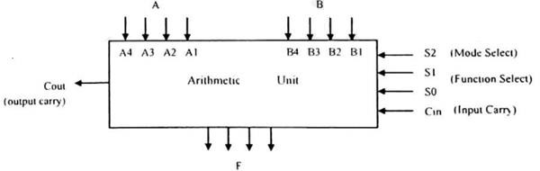
The input and output carries have meaning only during an arithmetic operation. The design of ALU can be carried out in 3 stages:
Design of Arithmetic section
Design of Logic section
Modification of arithmetic section so that it can perform both arithmetic and logic operations.

Slide 16
Design of arithmetic Circuit
The basic component of arithmetic section of an ALU is a parallel adder.
Parallel adder is constructed with a number of full adder circuits connected in cascade. By combining the data inputs to the parallel adder, it is possible to obtain different types of arithmetic operations.
The following figure demonstrates the arithmetic operations obtained when one set of inputs to the parallel adder is controlled externally. The no of bits in the parallel adder may be of any value.

Slide 17
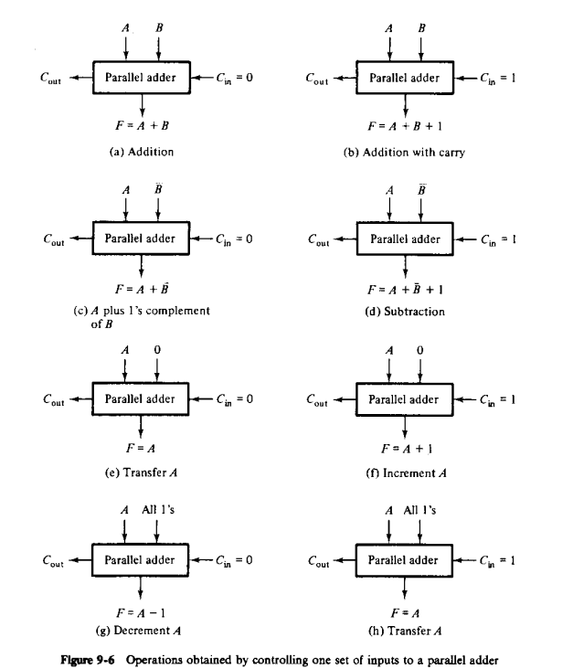

Slide 18
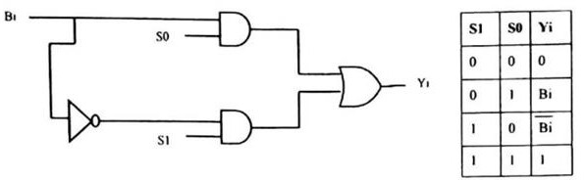
By changing the B input and Cin, we get 8 operations.
So the input B is applied in four different form by using following circuit.
The circuit that controls input B to provide the function is called a true/complement, one/zero element. This circuit can be shown as follows.

Slide 19
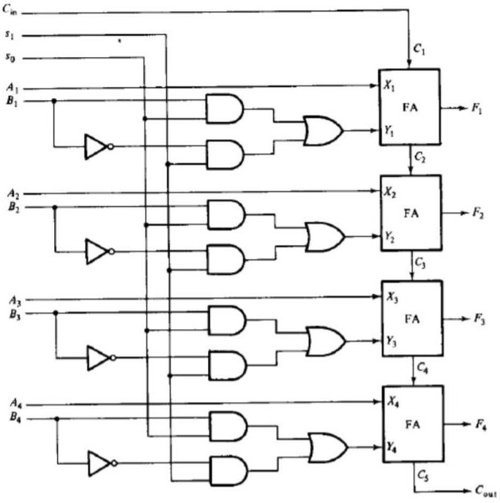
The A input is applied directly to the 4-bit parallel adder and the B input is modified. The resultant arithmetic circuit is shown in below figure.

Slide 20
Function select |  |  | Y equals | Output equals | Function
S1 | S0 | Cin
0 | 0 | 0 | 0 | F=A | Transfer A
0 | 0 | 1 | 0 | F=A+1 | Increment A
0 | 1 | 0 | B | F=A+B | Add B to A
0 | 1 | 1 | B | F=A+B+1 | Add B to A plus 1
1 | 0 | 0 | B’ | F=A+B’ | Add 1’s complement of B to A
1 | 0 | 1 | B’ | F=A+B’+1 | Add 2’s complement of B to A
1 | 1 | 0 | All 1’s | F=A-1 | Decrement A
1 | 1 | 1 | All 1’s | F=A | Transfer A

Slide 21
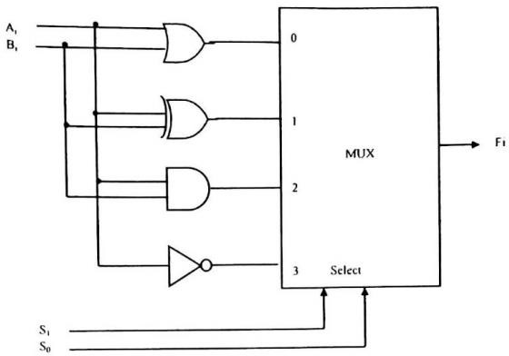
Design of Logic circuit
The logic microoperation manipulates bits of operands separately and treat each bit as a binary variable.
The 16-logic operation can be generated in one circuit and selected by means of four selection lines.
All logic operations can be obtained by means of AND, OR and NOT operations.
S1 | S0 | Output | Operation
0 | 0 | Fi=Ai+Bi | OR
0 | 1 | Fi=Ai Bi | XOR
1 | 0 | Fi=AiBi | AND
1 | 1 | Fi=Ai’ | NOT

Slide 22
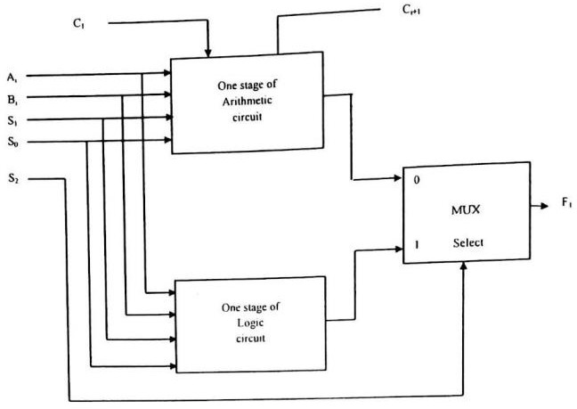
Final design of ALU unit by combining arithmetic circuit and logic circuit

Slide 23
Design of Combinational Logic Shifter
The shift unit attached to the processor transfers the output of the ALU onto the output bus.
Shifter may function in 4 different ways.
The shifter may transfer the information directly without a shift.
The shifter may shift the information to the right.
The shifter may shift the information to the left.
In some cases no transfer is made from ALU to the output bus.
A shifter is a bi-directional shift-register with parallel load. The information from ALU can be transferred to the register in parallel and then shifted to the right or left.
A combinational logic shifter can be constructed with multiplexers. The following figure will show the same.

Slide 24
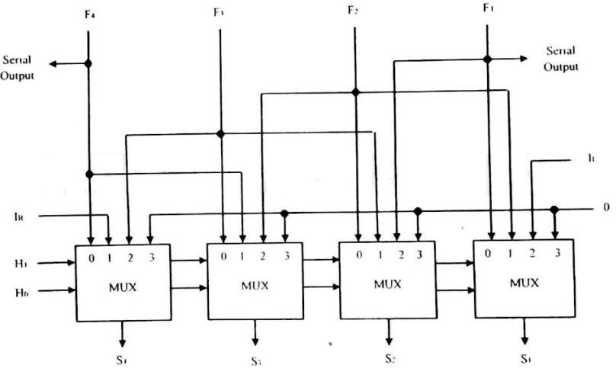
If H1 H0=00, no shift is executed and the signals from F go directly to the S lines.
If H1 H0=01, shift right is executed
If H1 H0=10, shift left is executed.
If H1 H0=11, no operation
H1 | H0 | Operation | Function
0 | 0 | S←F | Transfer F to S (no shift)
0 | 1 | S←shr F | Shift right F into S
1 | 0 | S←shl F | Shift left F into S
1 | 1 | S←0 | Transfer 0’s into S

Slide 25
If H1 H0=00, no shift is executed and the signals from F go directly to the S lines.
If H1 H0=01, shift right is executed
If H1 H0=10, shift left is executed.
If H1 H0=11, no operation
H1 | H0 | Operation | Function
0 | 0 | S←F | Transfer F to S (no shift)
0 | 1 | S←shr F | Shift right F into S
1 | 0 | S←shl F | Shift left F into S
1 | 1 | S←0 | Transfer 0’s into S

Slide 26
If H1 H0=00, no shift is executed and the signals from F go directly to the S lines.
If H1 H0=01, shift right is executed
If H1 H0=10, shift left is executed.
If H1 H0=11, no operation
H1 | H0 | Operation | Function
0 | 0 | S←F | Transfer F to S (no shift)
0 | 1 | S←shr F | Shift right F into S
1 | 0 | S←shl F | Shift left F into S
1 | 1 | S←0 | Transfer 0’s into S

Slide 27
If H1 H0=00, no shift is executed and the signals from F go directly to the S lines.
If H1 H0=01, shift right is executed
If H1 H0=10, shift left is executed.
If H1 H0=11, no operation
H1 | H0 | Operation | Function
0 | 0 | S←F | Transfer F to S (no shift)
0 | 1 | S←shr F | Shift right F into S
1 | 0 | S←shl F | Shift left F into S
1 | 1 | S←0 | Transfer 0’s into S

Slide 28
If H1 H0=00, no shift is executed and the signals from F go directly to the S lines.
If H1 H0=01, shift right is executed
If H1 H0=10, shift left is executed.
If H1 H0=11, no operation
H1 | H0 | Operation | Function
0 | 0 | S←F | Transfer F to S (no shift)
0 | 1 | S←shr F | Shift right F into S
1 | 0 | S←shl F | Shift left F into S
1 | 1 | S←0 | Transfer 0’s into S

Slide 29
Design of 4-bit Status Register
The relative magnitude of two numbers may be determined by subtracting one number from the other and then checking certain bit conditions in the resultant difference.
This status bit conditions are stored in a status register
The checking conditions may vary for signed and unsigned numbers. Status register is a 4-bit register.
The four bits are C (carry), Z (zero), S (sign) and V (overflow).
These bits are set or cleared as a result of an operation performed in the ALU.

Slide 30
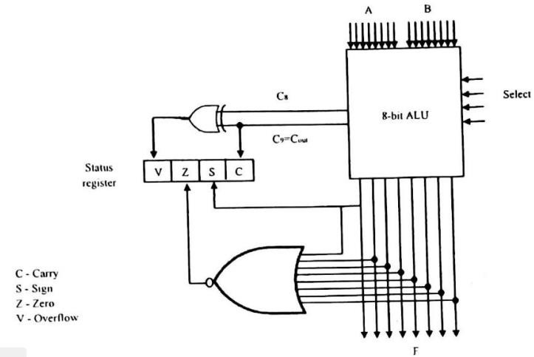
Bit C is set if the output carry of an ALU is 1. It is cleared if the output carry is 0.
Bit S is set to 1 if the highest order bit of the result in the output of
the ALU is 1. If the highest order bit is 0, this bit is cleared.
Bit Z is set to 1 if the output of the ALU contains all 0’s. That is if the result is zero Z bit is 1, and if the result is nonzero Z bit is 0.
Bit V is set if the exclusive OR of carries C8 and C9 is 1, and cleared otherwise. This is the condition for overflow when the numbers are in Signed 2’s complement representation.

Slide 31
After an ALU operation, status bits can be checked to determine the relationship that exist between the values of A and B.
If bit V is set after the addition two signed numbers, it indicates an overflow condition.
If Z is set after an exclusive OR operation, it indicates that A=B.
A single bit in A can be checked to determine if it is 0 or 1 by masking all bits except the bit in question and then checking the Z status bit.
Relation | Condition of Status bits | Boolean function
A<B | C=0 | C'
A<=B | C=1or Z=1 | C+Z
A>B | C=1 | C
A>=B | C=0 or Z=1 | C’+Z
A=B | Z=1 | Z
A≠ B | Z=0 | Z’

Slide 32
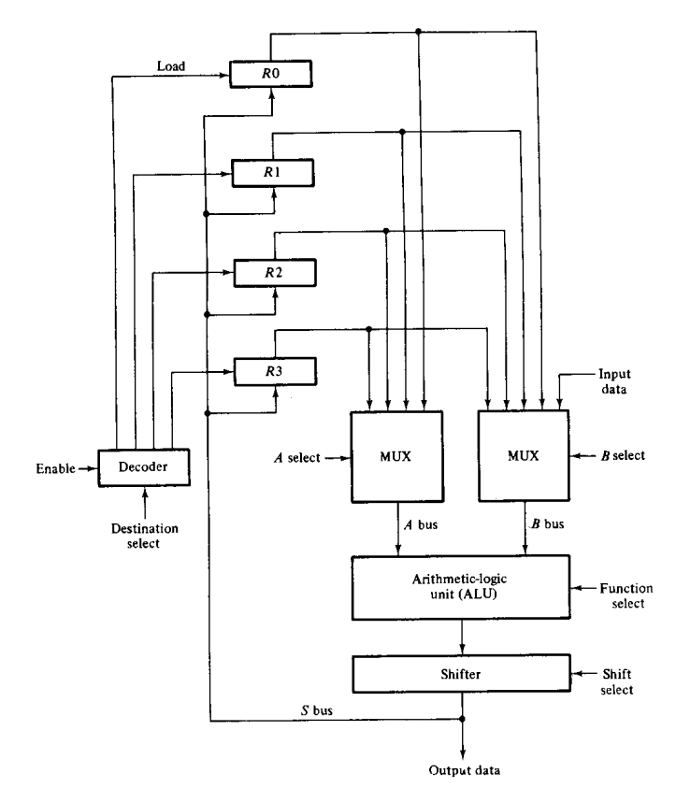
Processor Logic Design
Processor part of a computer is referred as data path of CPU
In a processor unit data path is formed by means of buses and other common lines.

Slide 33
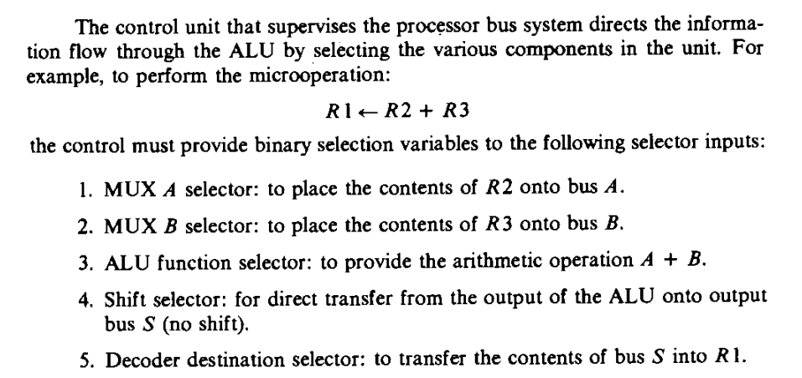

Slide 34
Processor with Scratchpad Memory
Registers in a processor unit can be included in a small memory unit
It is called scratchpad memory
It is cheaper compared alternative to connecting processor registers through bus system
In bus system the information transfer is selected by mux
But in scratchpad memory a single register must be selected by means of address to the memory unit
Also it is different from main memory as main memory stores instruction and data but information stored in scratchpad memory comes from main memory

Slide 35
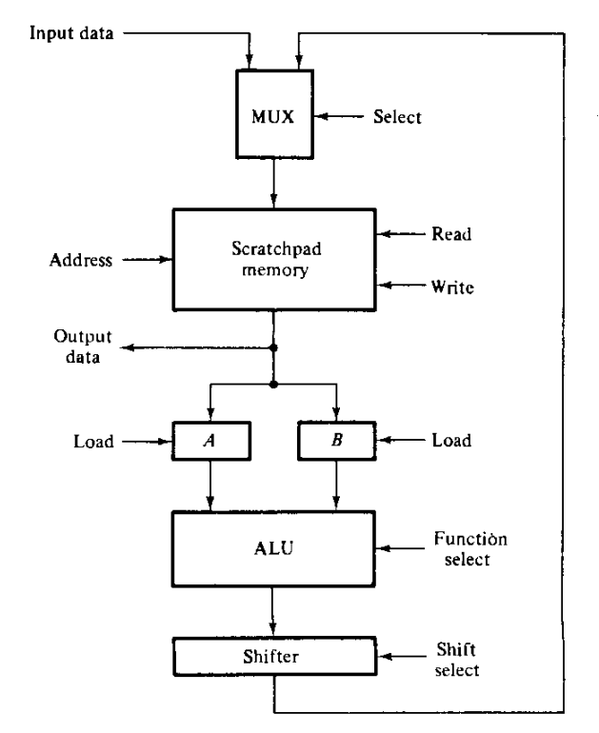

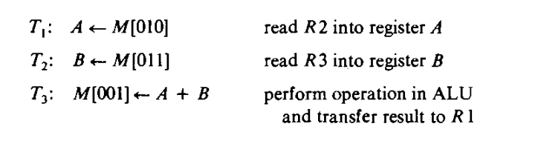
Processor with Scratchpad Memory

Slide 36
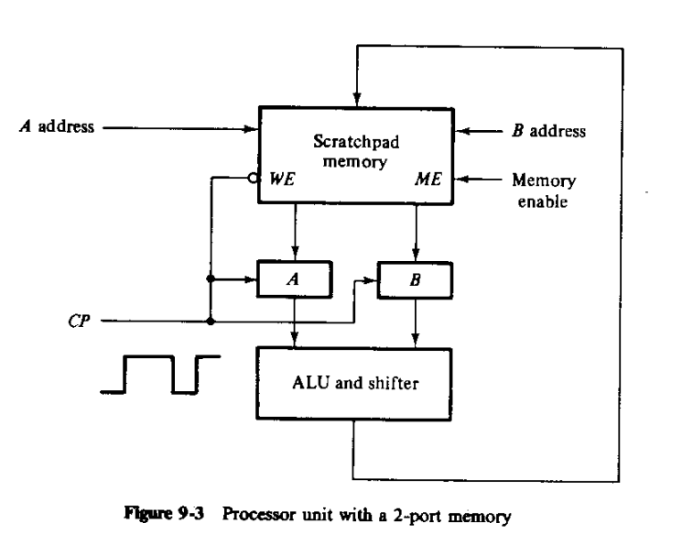
Processor with 2 port Memory
2 separate address lines to select 2 words of memory simultaneously

Slide 37
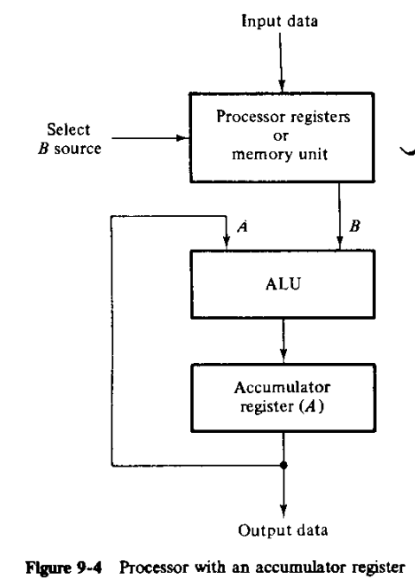

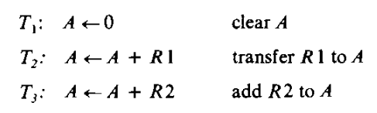
Accumulator register
Some processors use accumulator register for arithmetic operations
It is called an accumulator register, abbreviated AC or A register.
multipurpose register capable of perform­ing not only the add microoperation, but many other microoperations as well.
Gates associated with an accumulator register provide all the digital functions found in an ALU.

Slide 38
Block diagram of Processor Unit
The micro-operations within the processor during a given clock cycle can be determined by the selection variables.
The selection variables control the buses, the ALU, the shifter, and the destination register
It consists of seven registers (R1 to R7) and a status register.
The output of the seven registers goes through two multiplexers to select the inputs to the ALU.
If the input is given from any external source it can be accepted by the same multiplexers.
The output from the ALU goes through a shifter and then to a set of external output terminals.
It is also possible to transfer the content from shifter to any one of the registers.

Slide 39
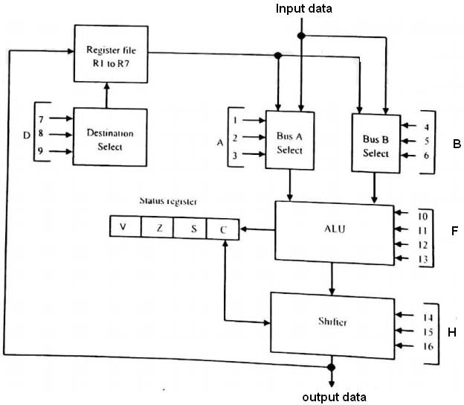

Slide 40

There are 16 selection variables in the unit. It can be specified by a control word.
The control word is partitioned into six fields, with each field is designated by a letter name. All the fields, except Cin, have a code of 3 bits.
A selects the input register for the left side of ALU.
B selects the input register for the right side of ALU.
D selects the destination register.
F and Cin bits together selects the function for ALU.
H selects the type of shift in shifter unit.

Slide 41
Binary code | Function of selection variable
 | A | B | D | F with Cin=0 | F with Cin=1 | H
000 | Input data | Input data | None | A,C←0 | A+1 | No shift
001 | R1 | R1 | R1 | A+B | A+B+1 | Shift right. I_{R}=0
010 | R2 | R2 | R2 | A-B-1 | A-B | Shift left. I_{L}=0
011 | R3 | R3 | R3 | A-1 | A,C←1 | 0’s to o/p bus
100 | R4 | R4 | R4 | AVB | ………. | …………
101 | R5 | R5 | R5 | A⨁B | ………. | Circulate right with C
101 | R6 | R6 | R6 | AɅB | ……… | ………….
111 | R7 | R7 | R7 | A’ | ……….. | Circulate left with C

Slide 42
The register selected by A, B, and D is the one whose decimal number is equivalent to the binary number in the code.
When the A or B field is 000, the corresponding multiplexer selects the input data.
When D = 000, no destination register is selected.
The 3 bits in the F field, together with the input carry Cin, provide the 12 operations of the ALU.
A control word of 16 bits is needed to specify a microoperation for the processor unit.
The most efficient way to is to store them in a memory unit which functions as a control memory.
The sequence of control words is then read from the control memory, one word at a time, to initiate the desired sequence of microoperations.
-This type of control organization is called Microprogramming.

Slide 43
Many microoperations can be generated in the processor unit by different variety of control words.
The control word for each microoperation is derived from the function table of the processor.
A processor unit with a complete set of microoperations is a general-purpose device that can be adapted for many applications.
The register-transfer method is a convenient tool for specifying the operations.
The sequence of control words for the system is stored in a control memory.
The output of the control memory is applied to the selection variables of the processor.
By reading consecutive control words from memory, it is possible to sequence the microoperations in the processor.

Slide 44
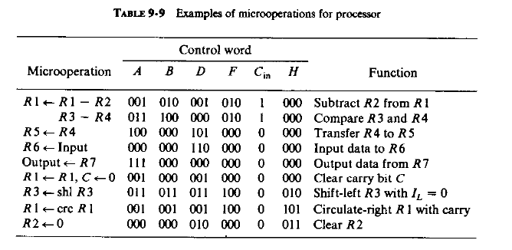
Ex:

Slide 45
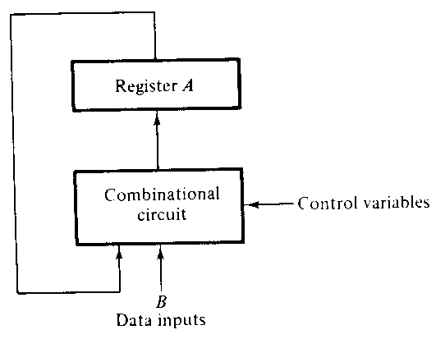
Design of accumulator
Special register - Accumulator Register.
A register= Accumulator register (AC)
The accumulator register is essentially a bidirectional shift register with parallel load which is connected to an ALU.
Because of the feedback connection from the output of the register to one of the inputs in the ALU, the accumulator register and its associated logic, when taken as one unit, constitute a sequential circuit.
And an accumulator register can be designed by sequential-circuit techniques instead of using a combinational-circuit ALU.
A register + associated combinational circuit = sequential circuit

Slide 46
The external inputs to the accumulator are the data inputs from B and the control variables that determine the micro operations for the register.
The next state of register A is a function of its present state and of the external inputs.
Accumulator can also perform data processing operations.
An accumulator is a multi-function register that, by itself, can be made to perform all of the microoperations in a processor unit.

Slide 47
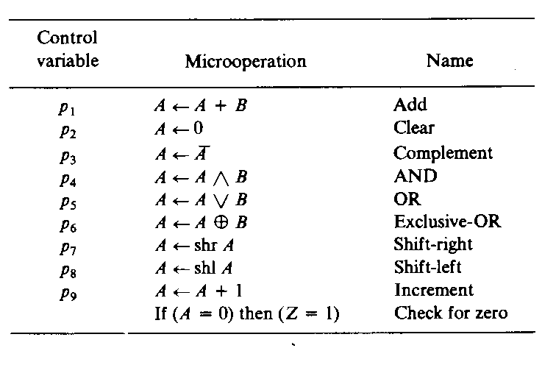
Total of 9 microoperations. is considered here for the design of accumulator circuit.
A=source register.
B =second source register.
Destination register =accumulator register
For a complete accumulator there will be n stages.

Slide 48
Control variables p1 to p9 are generated by control logic circuits and initiate the corresponding register-transfer operations.
Register A is a source register in all the listed microoperations.
The B register is used as a second source register for microoperations that need two operands.
The B register is assumed to be connected to the accumulator and supplies the inputs to the sequential circuit.
The destination register for all microoperations is always register A.
The new information transferred to A constitutes the next state of the sequential circuit.
The 9 control variables are also considered as inputs to the sequential circuit.
These variables are mutually exclusive and only one variable must be enabled when a clock pulse occurs.
The last entry in Table is a conditional control statement. It produces a binary 1 in an output variable Z when the content of register A is 0, i.e., when all flip-flops in the register are cleared.

Slide 49
One Stage of Accumulator
A typical accumulator stage consists of all the circuits that were designed for the individual microoperations.
Control variables p1 through p9 are Mutually Exclusive. ( i.e. only one at a time).
Present state | Next state | j | k
0 | 0 | 0 | x
0 | 1 | 1 | x
1 | 0 | x | 1
1 | 1 | x | 0

Slide 50
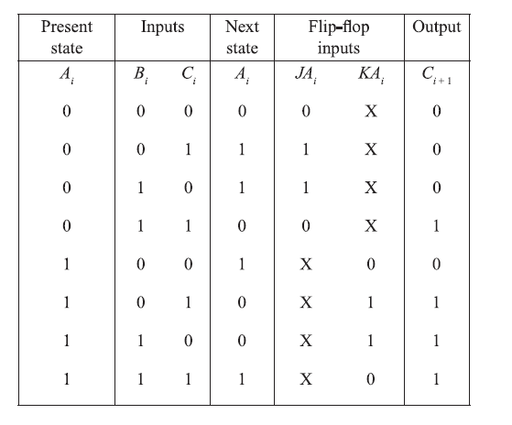

Slide 51
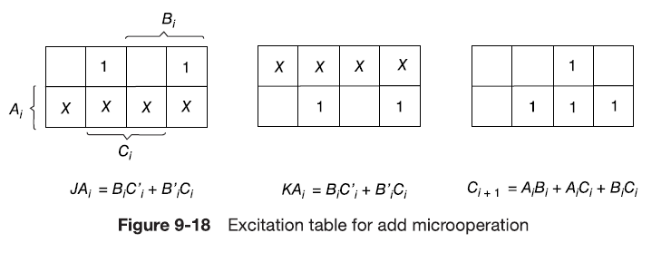
BC
00
11
10-
01
A

Slide 52
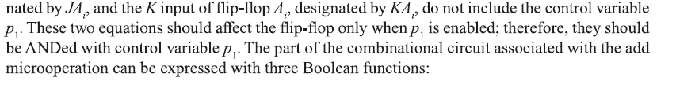
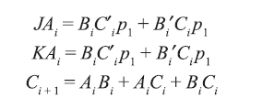
The j input is designated by

Slide 53

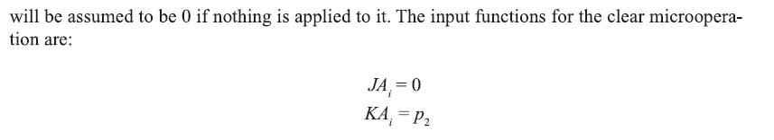
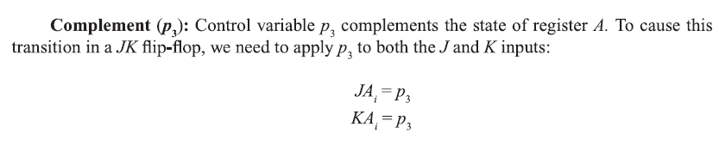

Slide 54
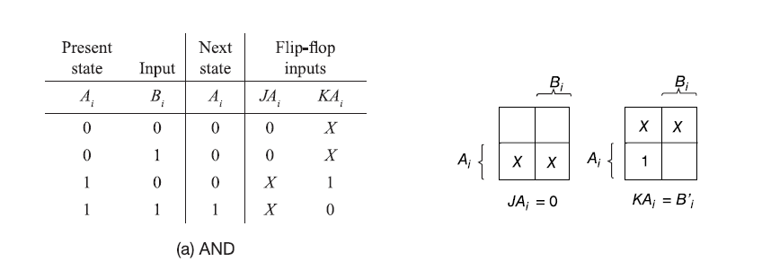
AND (p4): The AND microoperation is initiated with control variable p 4This operation forms the logic AND operation between Ai and Bi and transfers the result to Ai. The excitation

Slide 55
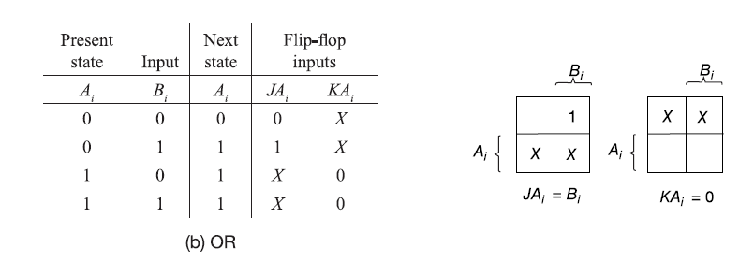

OR (p5): Control variable p5initiates the logic OR operation between Ai and B, with the result transferred to A,.

Slide 56
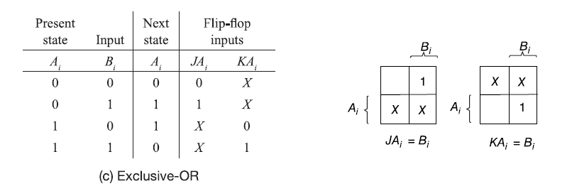

Slide 57
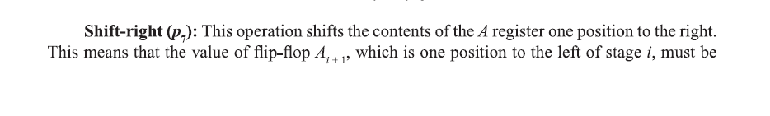
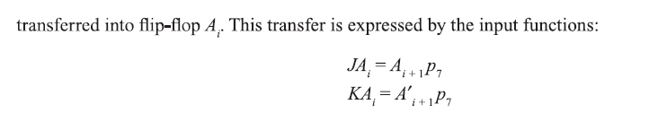

Slide 58
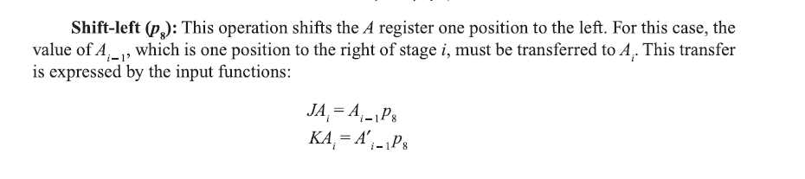

Slide 59
Increment (p9): This operation increments the contents of the A register by one; in other words, the register behaves like a synchronous binary counter withp₉ ^{enabling the count.}

Slide 60


Slide 61
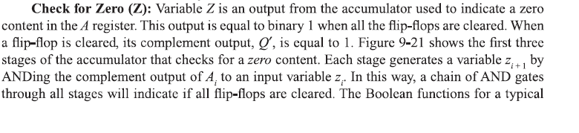
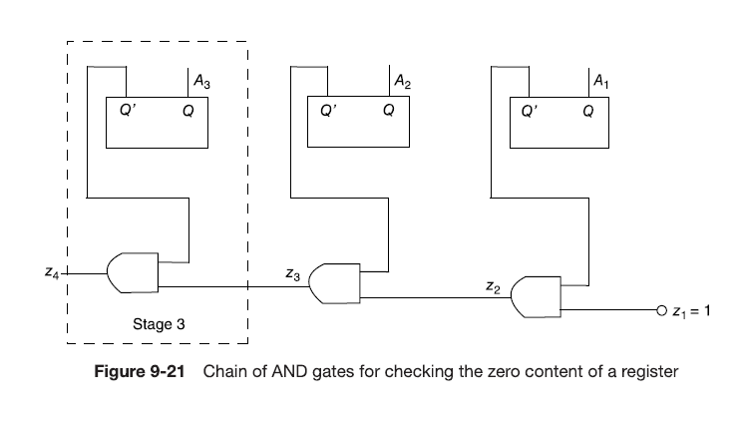

Slide 62
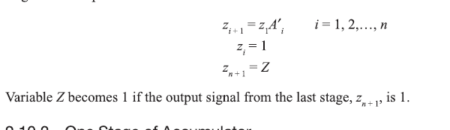

Slide 64
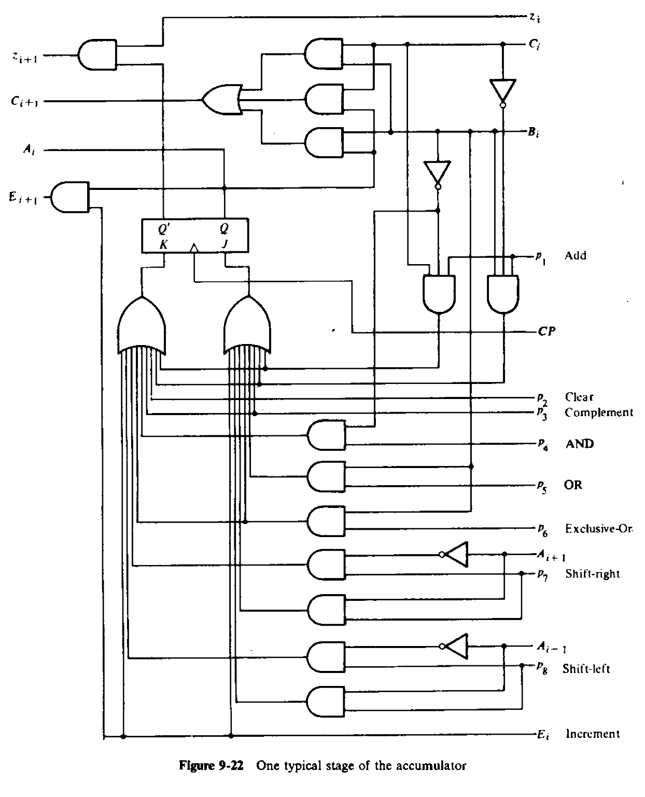

Slide 65
Complete Accumulator
The accumulator is to be partitioned into n stages, and each stage is to be partitioned into those circuits that are needed for each microoperation.
Once the various pieces are designed separately, it will be possible to combine them to obtain one typical stage of the accumulator and then to combine the stages into a complete accumulator

Slide 66
Complete Accumulator
An accumulator with n bits requires n stages connected in cascade, with each stage having the circuit shown in above Figure.
All control variables, except p9, must be applied to each stage.
The other inputs and outputs in each stage must be connected in cascade to form a complete accumulator.
The interconnection among stages to form a complete accumulator is illustrated in the 4-bit accumulator shown below.

Slide 67
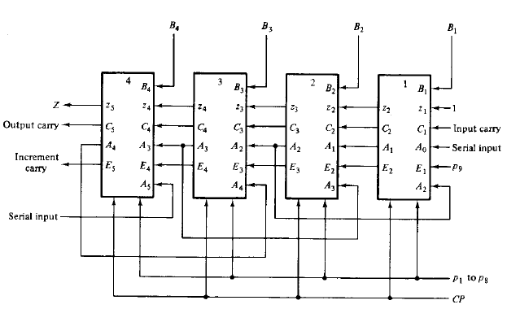
Fig: 4-bit Accumulator constructed with 4 stages

Slide 68
The number on top of each block represents the bit position in the accumulator.
All blocks receive 8 control variables, through p1 to p8, and the clock pulses from CP.
The other 6 inputs and 4 outputs in each block are identical to those of a typical stage.
The circuit has four B inputs.
The zero-detect chain is obtained by connecting the z variables in cascade.
The last stage in this chain produces the zero-detect variable Z.
The carries for the arithmetic addition are connected in cascade as in full-adder circuits.

Slide 69
The serial input for the shift-left operation goes to input A0, which corresponds to input A i-1 in the first stage.
The serial input for the shift-right operation goes to input A5, which corresponds to A i+l in the fourth and last stage.
The increment operation is enabled with control variable in the first stage.
The other blocks receive the increment carry from the previous stage.
The total number of terminals in the 4-bit accumulator is 25, including terminals for the A outputs.
Incorporating two more terminals for power supply, the circuit can be enclosed within one IC package having 27 or 28 pins.
The number of terminals for the control variables can be reduced from 9 to 4 if a decoder is inserted in the IC.
In such a case, the IC pin count can be reduced to 22 and the accumulator can be extended to 16 microoperations without adding external pins.

